Slide 1
Quantitative Research in Political Science
Giuseppe Carteny
Postdoctoral Researcher
Alex Hartland
Postdoctoral Researcher
Department of European Social Research
University of Saarland
UdS SoSe2025 - Intro

Slide 2

Who am I?
Dr. Giuseppe Carteny
I have been a postdoctoral researcher (Wissenschaftlicher Mitarbeiter) at the chair of Prof. Dr. Daniela Braun since 2023
I have been postdoctoral researcher at the Mannheim Centre for European Social Research (MZES) of the University of Mannheim
I research gender-related issues and how far-right is twisting these in UNTWIST project
I obtained my PhD in Political Studies at the University of Milan, and studied political science at the LUISS University of Rome
I use public opinion surveys, experts’ data, party manifestos,… to investigate social and political phenomena in Europe and East Asia

Slide 3
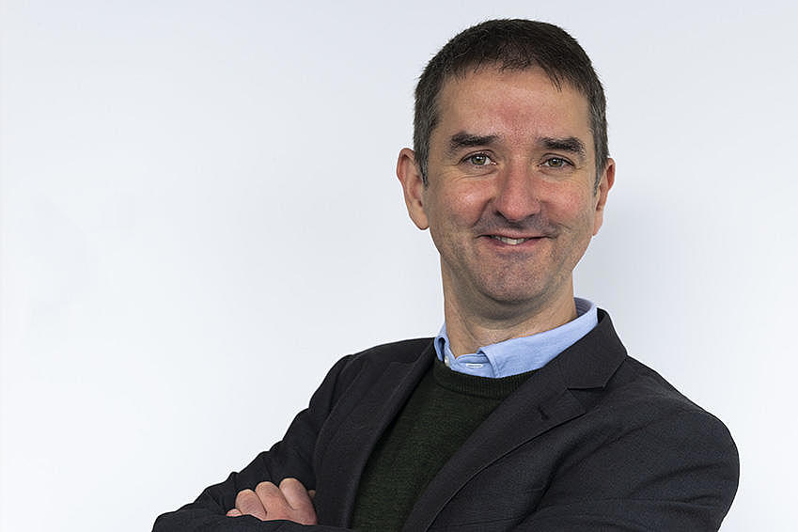
Who am I?
Dr. Alex Hartland
I have been a postdoctoral researcher (Wissenschaftlicher Mitarbeiter) at the chair of Prof. Dr. Daniela Braun since 2023
I studied psychology at the University of Warwick and politics at the University of Manchester, UK
I research political trust and polarisation in European politics as part of the ActEU project
I use surveys and online content to answer questions about current political developments
For our project, we collected content from Twitter/ X, Telegram, and news sites in 10 countries
How can we analyse this and similar content to better understand what is happening online?

Slide 4


Structure of the course
How to Apply the Classical Toolbox
First six classes
Giuseppe
How to Analyse Digital Content for Political Science Research
Second six classes
Alexander

Slide 5
Structure of the course
Class 1 – Intro: Motivation, materials, aims, requirements,… revising R basics
Class 2 – The first bricks: Data structures, basic statistical concepts, and measures,
Class 3 – Going multivariate! Generalised linear models, and the bread and butter of multivariate methods (i.e., the linear model)
Class 4 – Make your analyses understandable! Quantities of interest and how to visualize them
Class 5 – How to deal with categories and counts: Probit, Logit, & friends
Class 6 – Outro: Review/How to apply these methods to your research questions

Slide 6
Structure of the course
Class 7 – Introduction: course overview, technical set up, where to find content
Class 8 – Getting an Overview: import, clean, and measure quantities at scale
Class 9 – Going Deeper: using word embeddings to measure attitudes
Class 10 – New Developments: analysing text with Large Language Models
Class 11 – Other content: images, video, and the future of online content analysis
Class 12 – Review/ Applying Text Analysis to your own research question

Slide 7
Why this course?
Learning Aims
How to collect and analyse text, images, and related information online, or existing datasets about political attitudes and political behaviour
How to use this information to measure:
- salience - which topics are getting the most attention?
- political attitudes - positive or negative expressions, support or opposition, polarisation, trust, democratic values
- political behaviour - likes, reposts, follows, participation, protest, radicalisation
How to compare results across political actors, parties, platforms, and countries to address research questions

Slide 8
Why this course?
Question you might want to address:
Are democracies less prone to war?
Are parties becoming more polarised over time?
Are young voters more progressive than older ones?
Are far-right actors spreading dis/misinformation more online than other actors?
Is Elon Musk a fascist?
Which parties focus on which topics?
How do we know our results are accurate?
Can we use this information to predict future events? (spoiler: yes, but not reliably!)

Slide 9
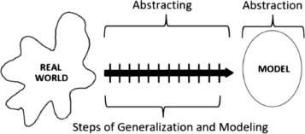
Why this course?
One of the main goals of science is generalisation
Some political science questions aim to make generalisations about populations
If you want to make claims about populations you need tools for investigating them
And you need to know idea about how these tools work!

Slide 10
Why this course?
Do you want to become a political scientist?

Slide 11
Why this course?
Do you want to become a political scientist?

Slide 12
Why this course?
Do you want to become a political scientist?

Slide 13
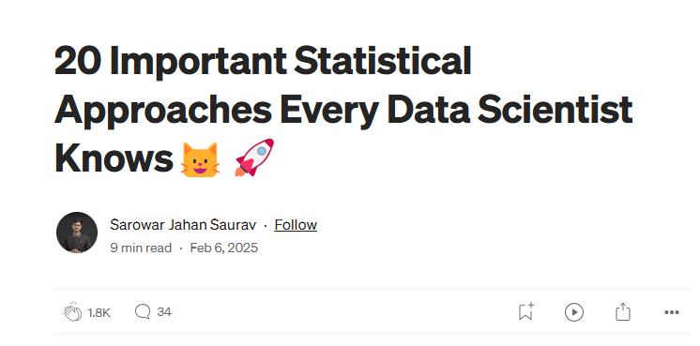
Is this useful?
Even if you don’t want to be a researcher (and you want have a normal life, with a well-paid job)… you might still want to learn these skills!
These courses would teach you foundational skills for:
Data science
Machine learning
Market research
Brand management
Digital journalism
Cyber security
Legal analysis
Financial planning and more...
Bayesian Inference Maximum Likelihood Estimation (MLE) Hypothesis Testing (t-test) Analysis of Variance (ANOVA) Principal Component Analysis (PCA) Factor Analysis
Cluster Analysis (K-means) Bootstrapping Time Series Analysis (ARIMA) Time Series Analysis (ARIMA) Multivariate Regression (Multiple Linear Regression) Ridge/Lasso Regression Logistic Regression Mixed Effects Models Nonparametric Tests Monte Carlo Simulation Markov Chain Monte Carlo (MCMC) Robust Regression Copulas Generalized Additive Models (GAMs)

Slide 14
Why this course?
But most importantly what you’ll learn is to
THINKING CLEAR WITH DATA

Slide 15
Thank you for your attention!

